Slide 1
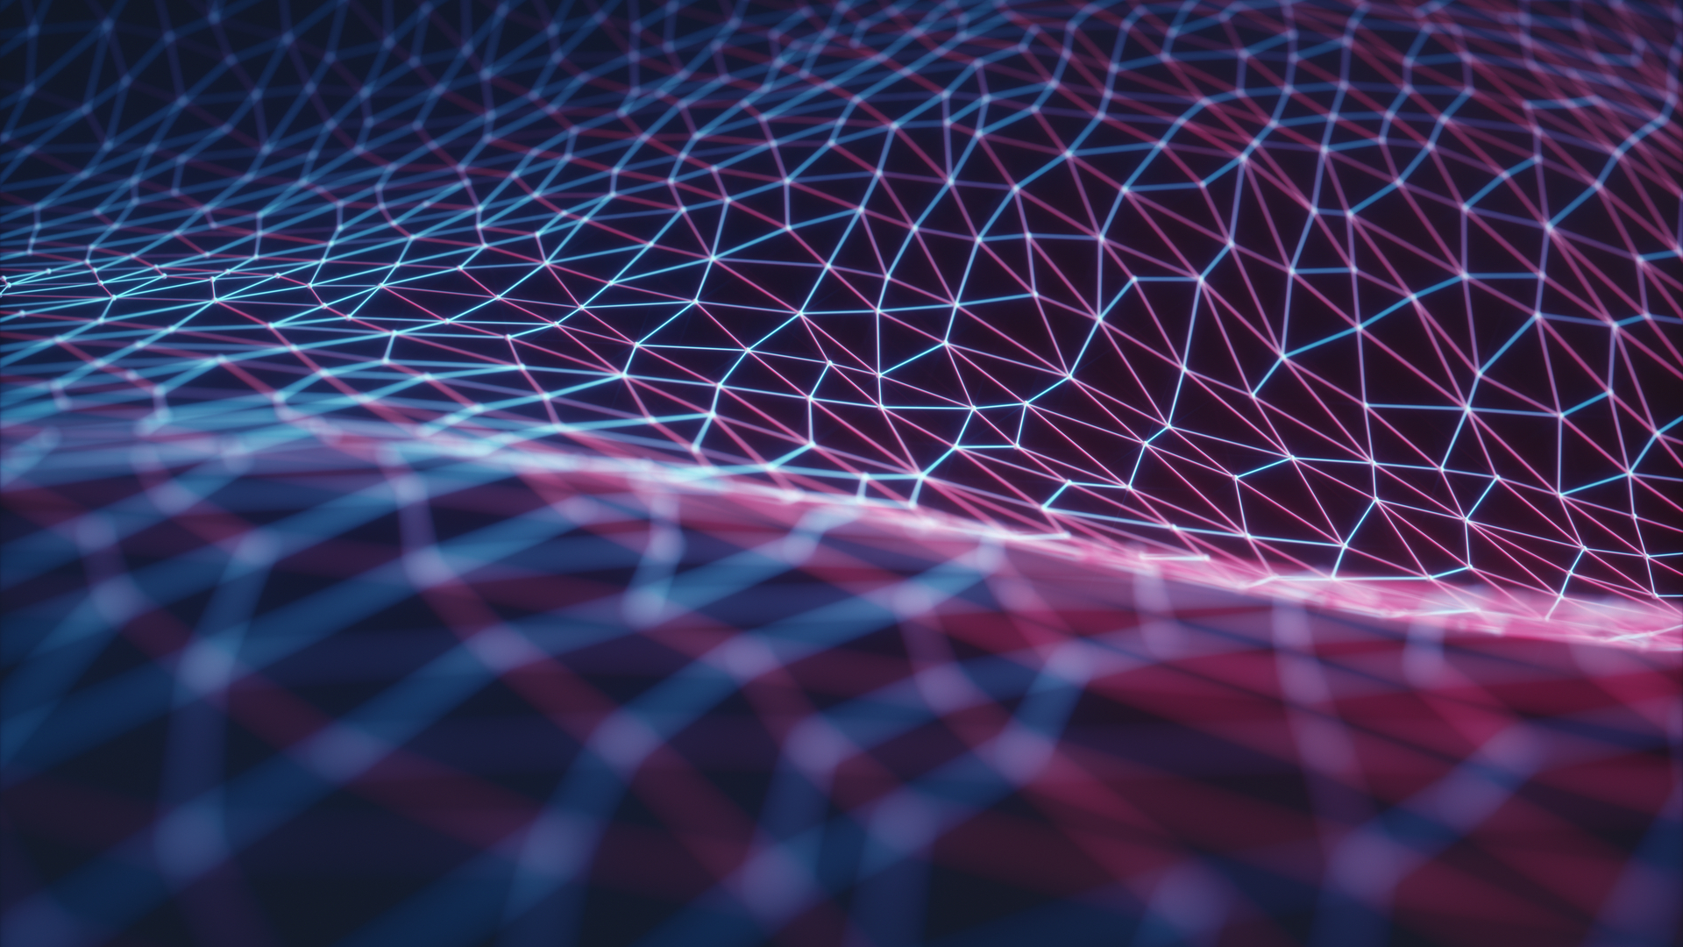

Developers: Jack Cordonnier & Ben Elfner
Project Advisor: Ali Minai
Notes:
Jack

Slide 2
Intellectual Merits
This project brings together the technologies of Neural Networks into a game engine like Unity.
The AI will use its “senses”, to understand and navigate it’s terrain by using a visual representation of the world around it. This is significant, because the AI will use image recognition as opposed to reading game variables to make it’s choices.
Modern video game AI’s, even neural network based ones, usually directly read and interact with the games code.
This AI however, works in a more real world way since it only sees a simplified version of what a human would see and controls itself with the same controls a human uses.
Notes:
Ben

Slide 3
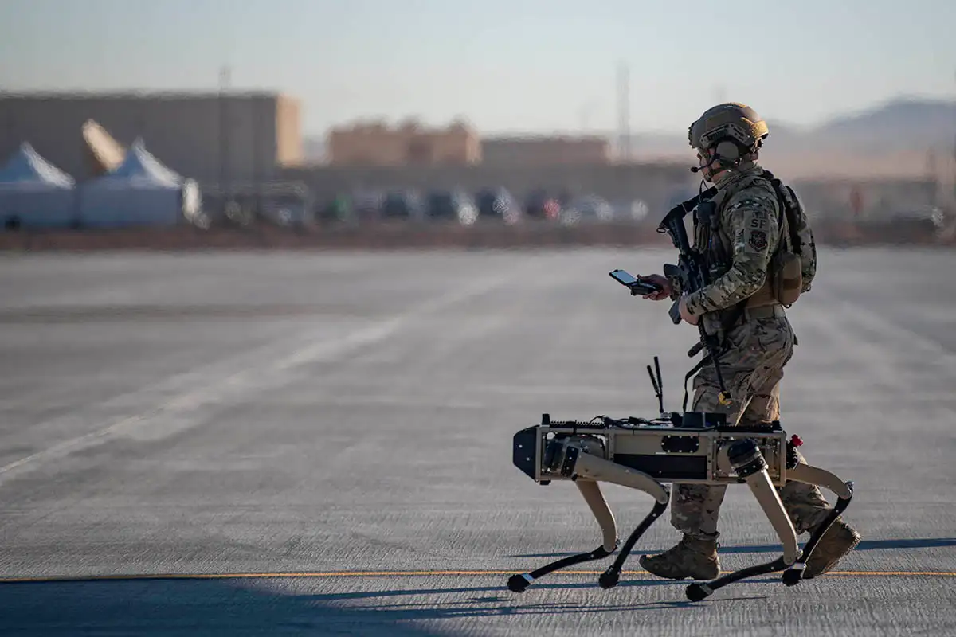
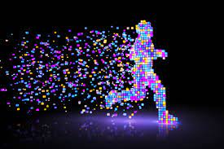
Broader Impacts
AI’s that are capable of learning and reacting from other AI’s or humans have a variety of applications
Military devices
Smart movement and navigation
Adapting to terrain changes
The combination of a video game with a trained neural network AI can allow for a freshness and uniqueness to the gameplay
A departure from the usual hardcoded AI
More flexible and less stiff since it can adjust to stimuli
The project illustrates a crude way to use a neural network to problem solve
Notes:
Jack

Slide 4
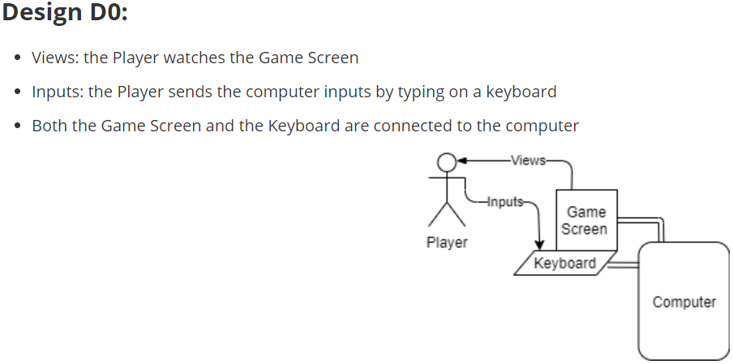
Design Diagrams (D0)
Notes:
Ben

Slide 5
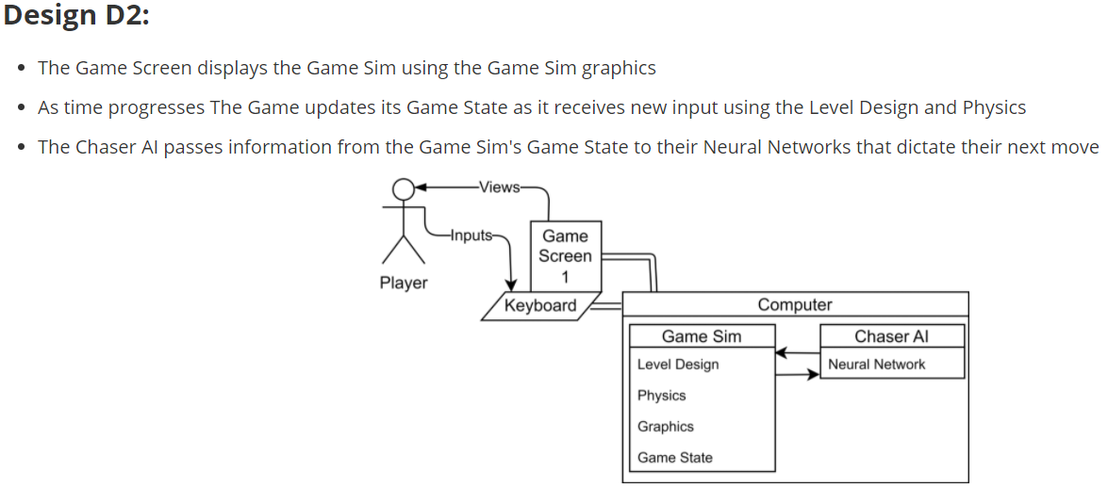
Design Diagrams (D2)
Notes:
Ben

Slide 6




Technologies
Unity (C#) - Game Environment and Agent Control - Controls the, menus, visuals, and functional aspects of the game. Provides the AI with a medium to move and interact with
Python (using sockets) - Server - Hosts data, sends and receives information back and forth from the game
Tensorflow - Neural Network - Digests visual input from game, outputs response from Neural Network, data will be sent with the server to the game
Gimp - Image Design and Editing - Allows for the creation and development of images for use in the game
Notes:
Jack

Slide 7
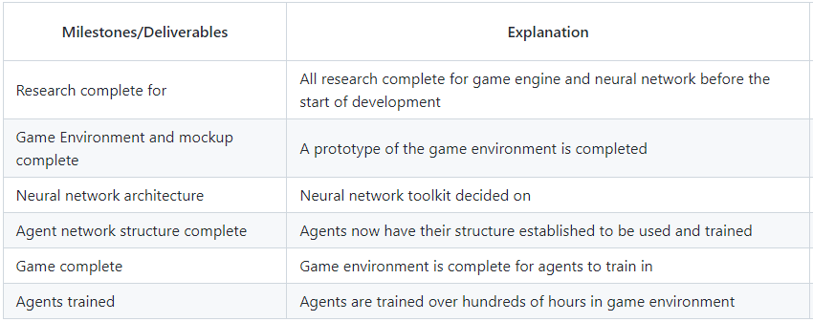
Project Results (So far)
Notes:
Ben

Slide 8
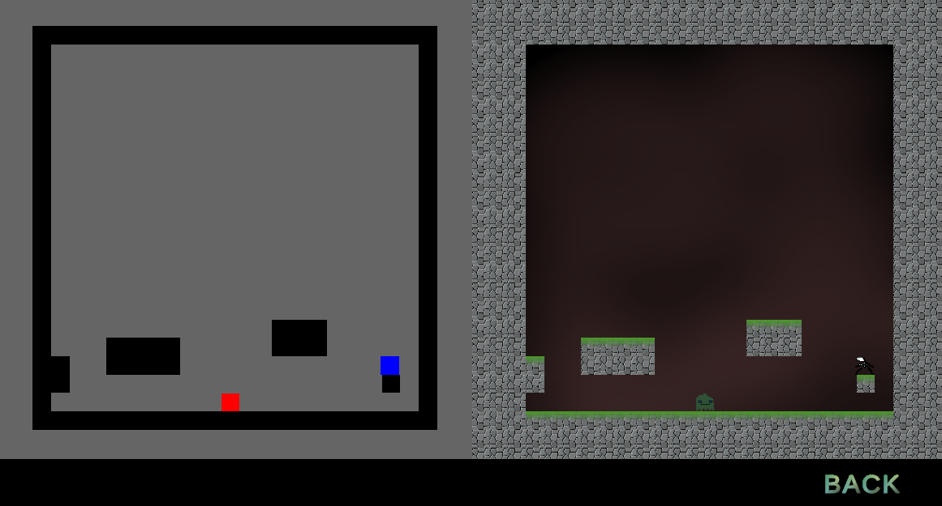
Challenges
There have been three main challenges we have faced during development.
Steep learning curve for the technologies we need to utilize
Long training time for the neural network to see moderate results
Designing the model of the neural network to optimize learning and training time of the AI
Notes:
Jack

Slide 9
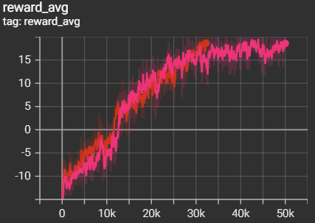
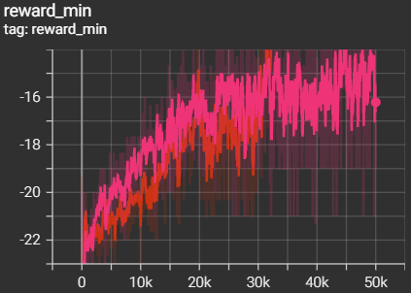
Current Progress
Notes:
Ben

Slide 10
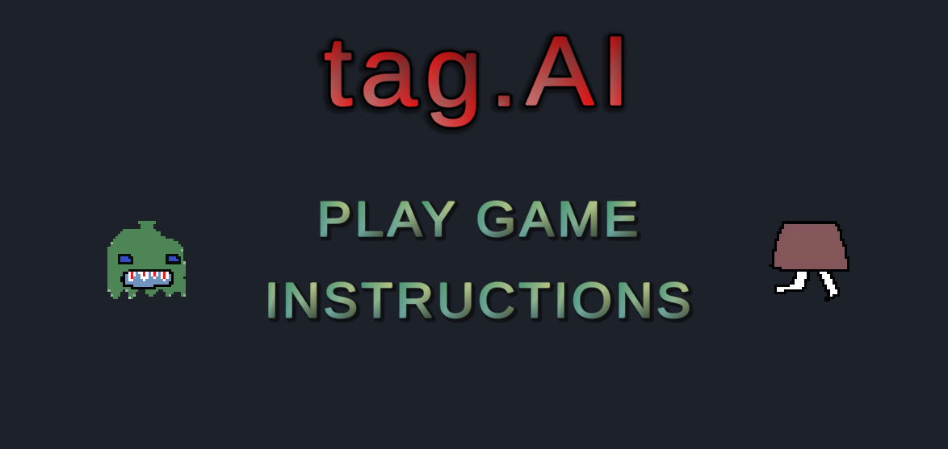
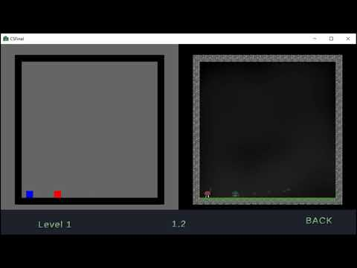
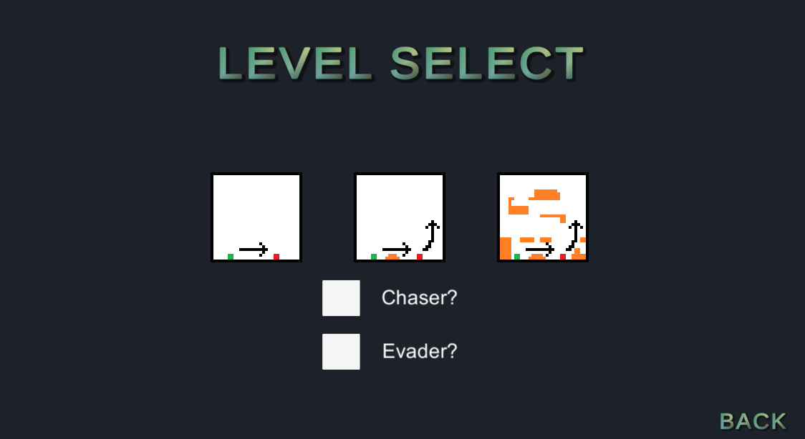
Demo
Notes:
Jack

Slide 11
Thanks for listening!

